Slide 1
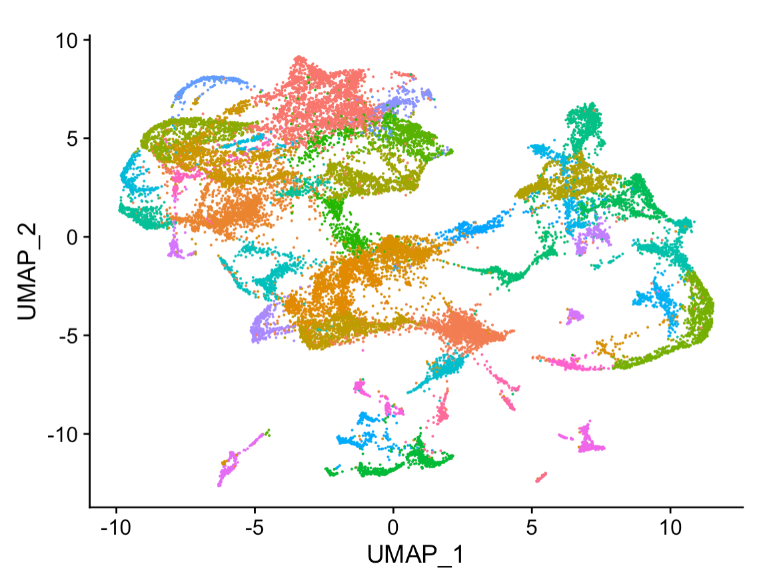
Good Data Practices For Machine Learning
NetNeuro 2023

Slide 2
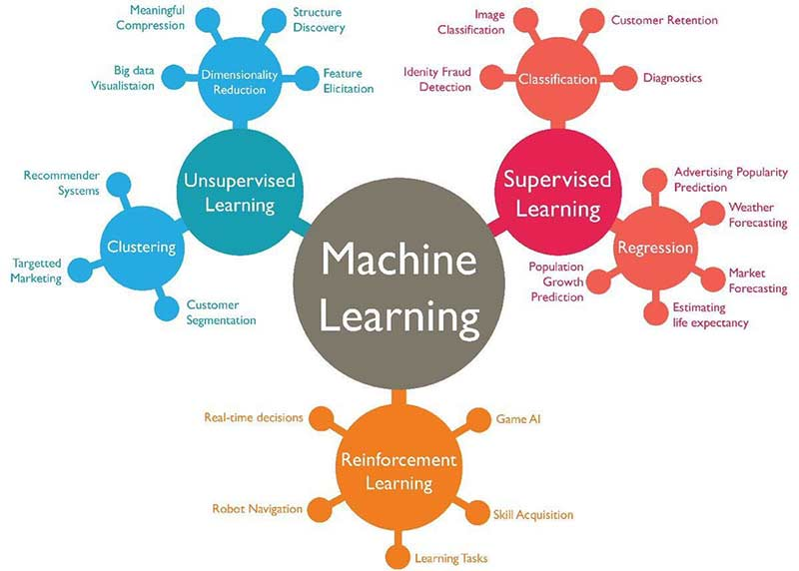
Reminder ML Types

Slide 3
ML Experiment
Define your problem
Gather preliminary or existing data
Fit a test model
Use a learning curve fit to estimate how much more data you might need
Use importance or attribution to look for confounders that might affect your data
Gather data and experiment with new models
Deploy/Publish – Return to 6

Slide 4
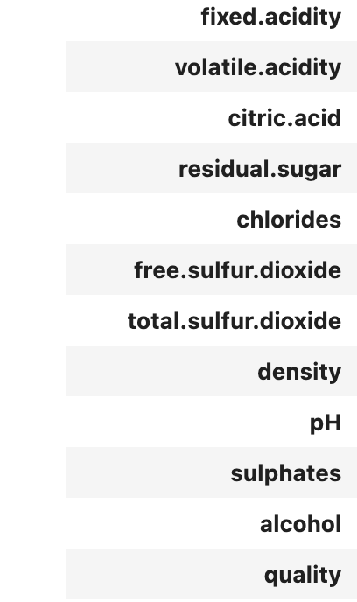
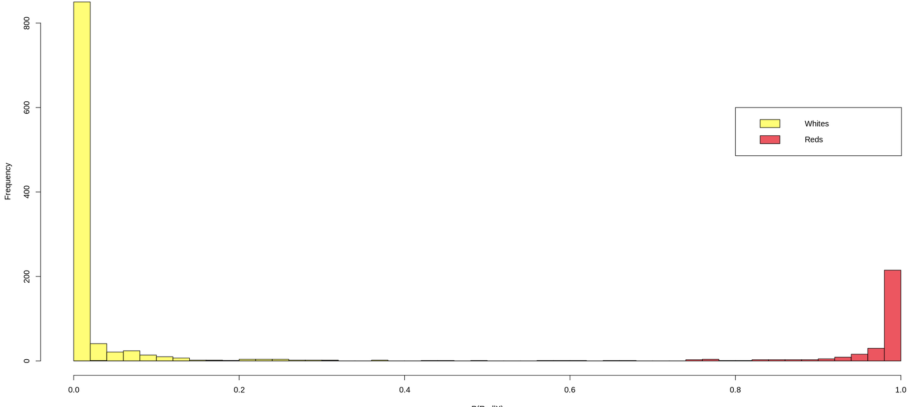
Programming Power-up Example
Inputs:
Algorithm = Random Forest
Outputs Probability of a wine being Red or White

Slide 5
It’s All About Data
Good Machine Learning starts with good datasets
What makes a dataset ‘good’
Reproducible
‘FAIR’ – Finable Accessible Interoperable and Reusable
How to plan out your data taking
What makes a data set ‘AI-Ready’

Slide 6
Splitting Datasets?
Machine Learning Algorithms learn from data
Often powerful enough to ‘memorize’ or overfit data
You’re training ML models to work with new data
Memorizing training data isn’t good enough
Normally called generalization
We want models to learning something from the training data the applies to future data as well
How do we know if the model generalizes?
We check by splitting off some test data
In contests the testing labels aren’t published
In research settings we use testing data to compare models
In both cases it’s useful for the dataset creator to decide, so it’s consistent moving forward

Slide 7
Important Best Practice
When splitting your dataset you may have several examples from a single subject.
i.e. you’re looking at a number of time windows in EEG data, or you have a number of FMRI datapoints
Often we want to say our results translate to new subjects
To make this claim you need split you data set by Subject
Not by data points, i.e all the data points for a subject should be in either a test/train or validation
Example:Retraction Note: Machine learning of neural representations of suicide and emotion concepts identifies suicidal youth

Slide 8
What Makes a Dataset AI Ready?
Clear Data Splits
Designate some examples as training data
Designate some examples as testing data
Structured Data is ‘Tidy’ - https://vita.had.co.nz/papers/tidy-data.pdf
Every column is a variable.
Every row is an observation.
Every cell is a single value.
The Dataset is Clean
No missing values or ‘Nans’
No ‘bad’ data
Consistent as Possible

Slide 9
Where do you make your data AI ready?
Published Dataset
Website, application, other output
Protocol
Figures
Tables
Numerical Summaries
Methodological code
Analytic Data
Computational Results
Measured Data
Published Article
Processing code
Analytic code
Visualization + presentation code
Adapted from R. Peng

Slide 10
Example Differences between Reproducible and AI-Ready
Blurry Image results from Bad Calibration
Useful for your future-self to debug
Not useful for training an ML model
An instrument is broken, so you’re missing a variable
Useful if you don’t need that variable
Not useful for training an ML model that needs that variable
Contaminated Sequences
Useful for your future-self to debug
Not useful for training an ML model
You switch units on an instrument
Useful it’s still the same data
Not useful for training an ML model you must convert to consistent units in advance
When taking data consider recording whether your confident if that data should be used for science or if there is a possibility something went wrong. This can help you clean your data for ML projects, can True/False, or more fine grained red/yellow/green.

Slide 11
AI Ready Data
Clear Data Splits
Designate some examples as training data
Designate some examples as testing data
Structed Data is ‘Tidy’ - https://vita.had.co.nz/papers/tidy-data.pdf
Every column is a variable.
Every row is an observation.
Every cell is a single value
The Dataset is Clean
No missing values or ‘Nans’
No ‘bad’ data
Consistent as Possible

Slide 12
Sometimes it’s ok to break the rules!
It’s often OK to break the rules when make AI-Ready Datasets. Just make sure you know why
Examples:
Some ML algorithms can handle missing values
Most can not, so make sure to check
There are other ways of validating ML models besides a training and test split
Cross validation - K-Folds, Leave one out
These are often computationally expensive, so generally they work with small models and small datasets where you want to use as much data as possible for training
A good reference for how to do cross validation
Assessing and tuning brain decoders (Varoquaux G. et. al 2017): Cross-validation, caveats, and guidelines: https://www.sciencedirect.com/science/article/pii/S105381191630595X?via%3Dihub

Slide 13
ML Data Content
ML models are programed with data
Beyond technical requirements the content of the data is important
What is in your data determines how your model works
Will it generalize
Will it be able to train
How accurate will it be

Slide 14
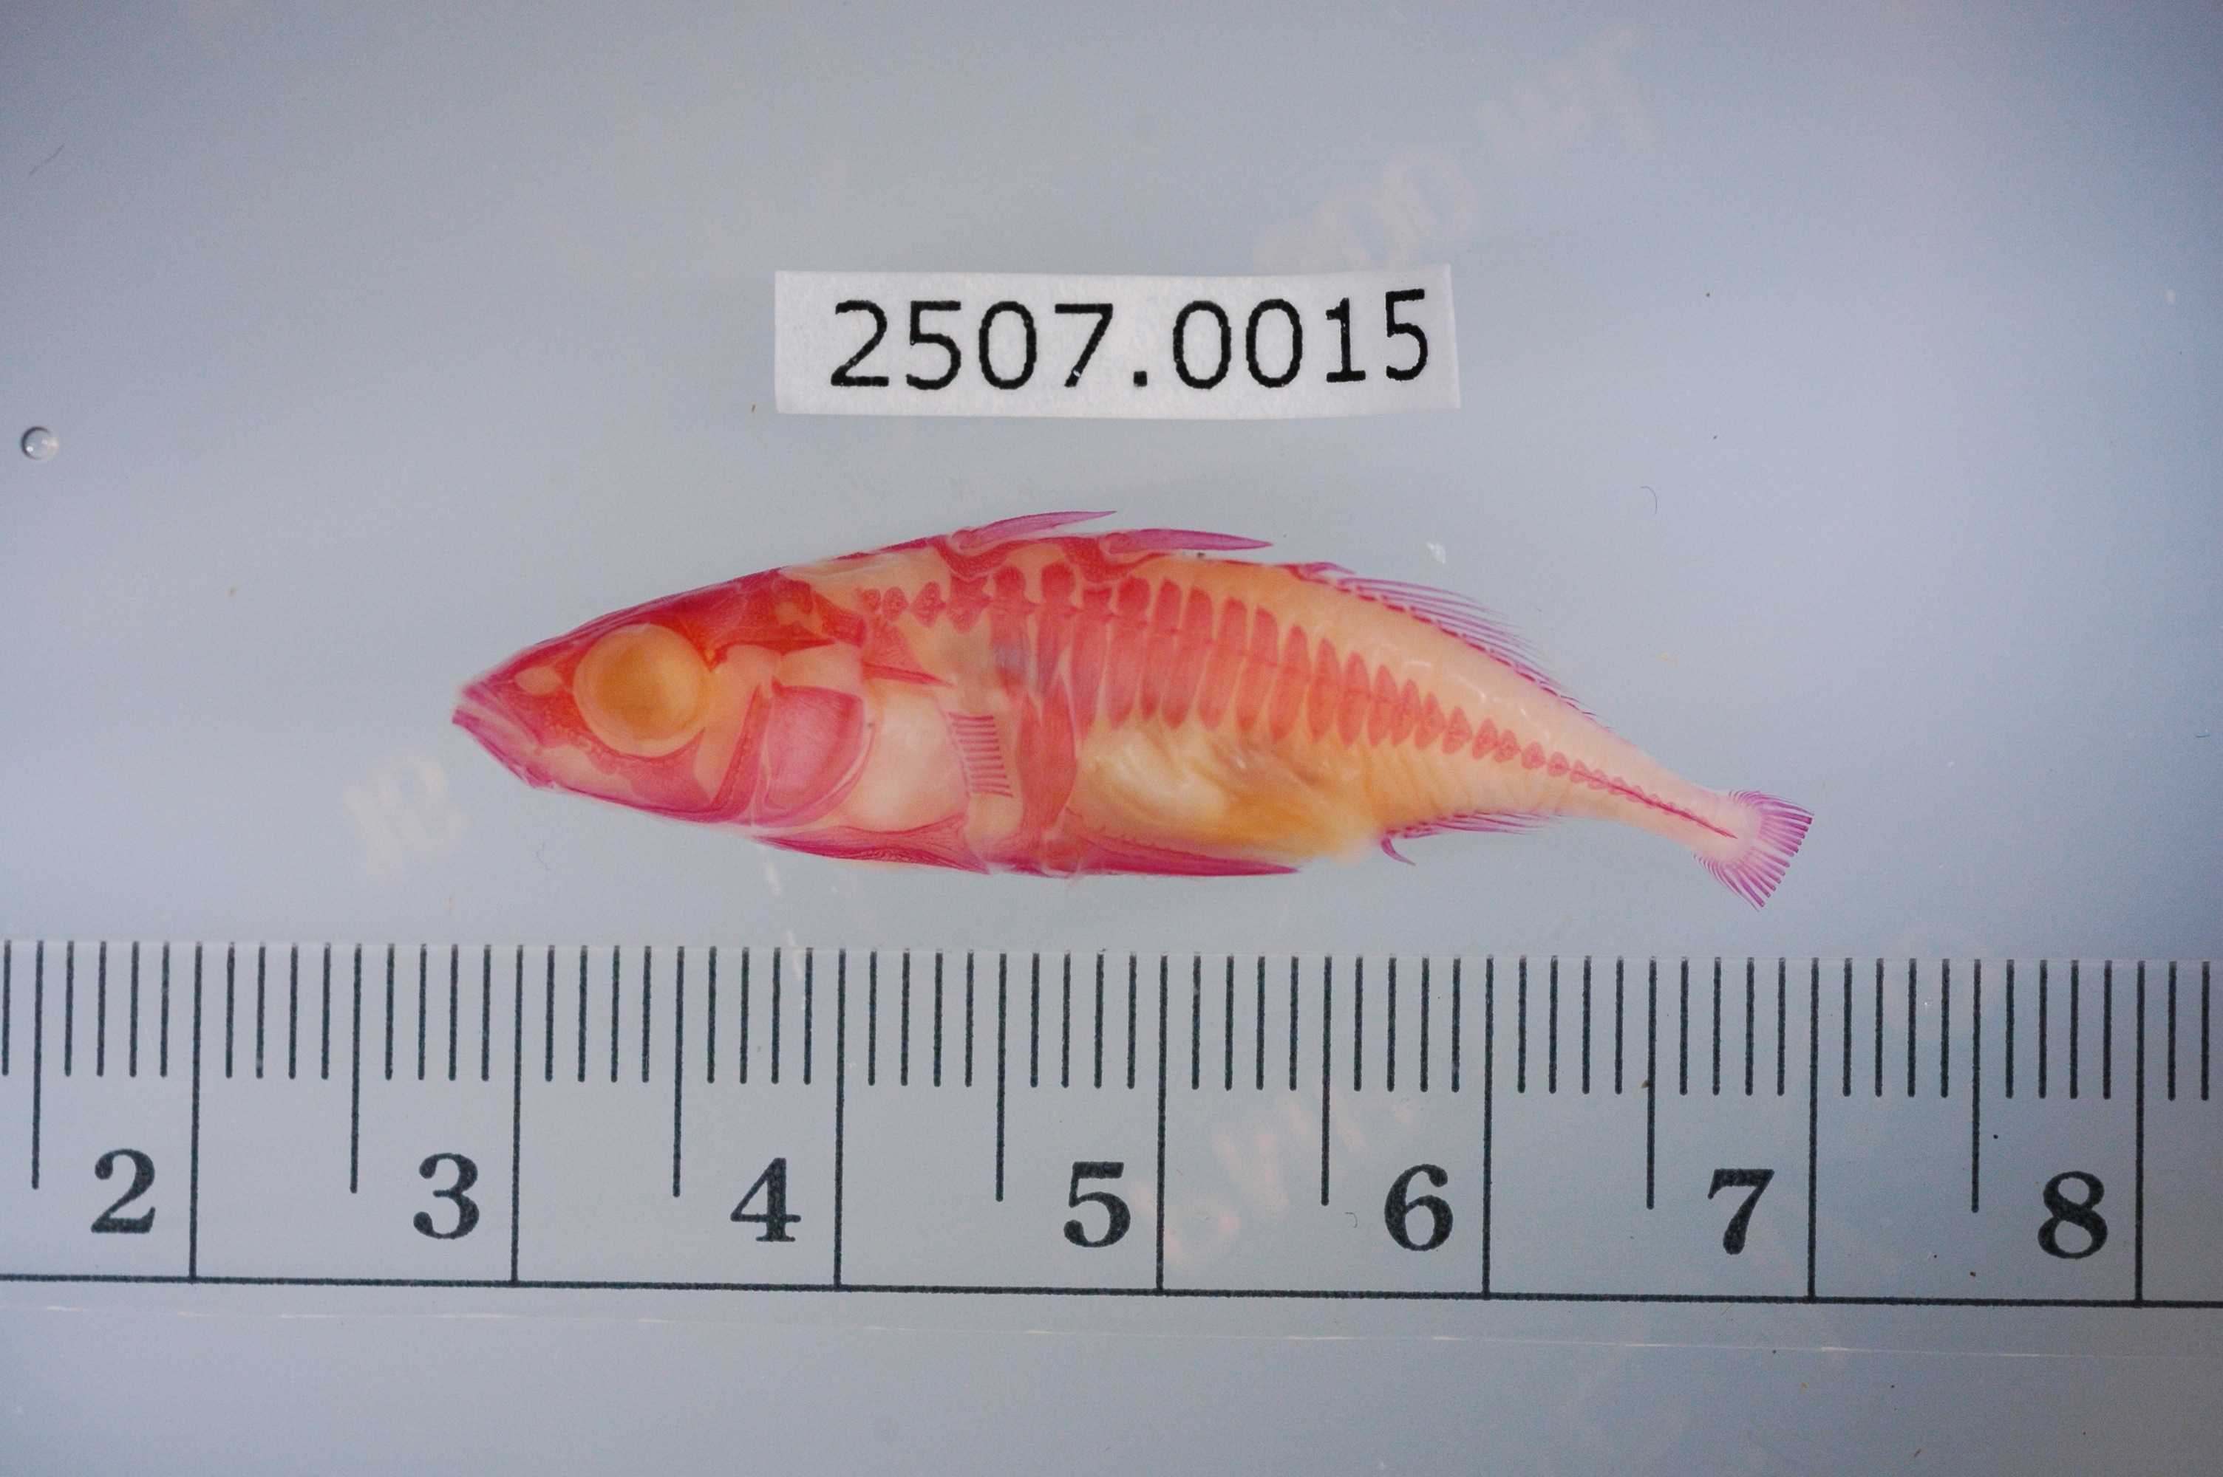
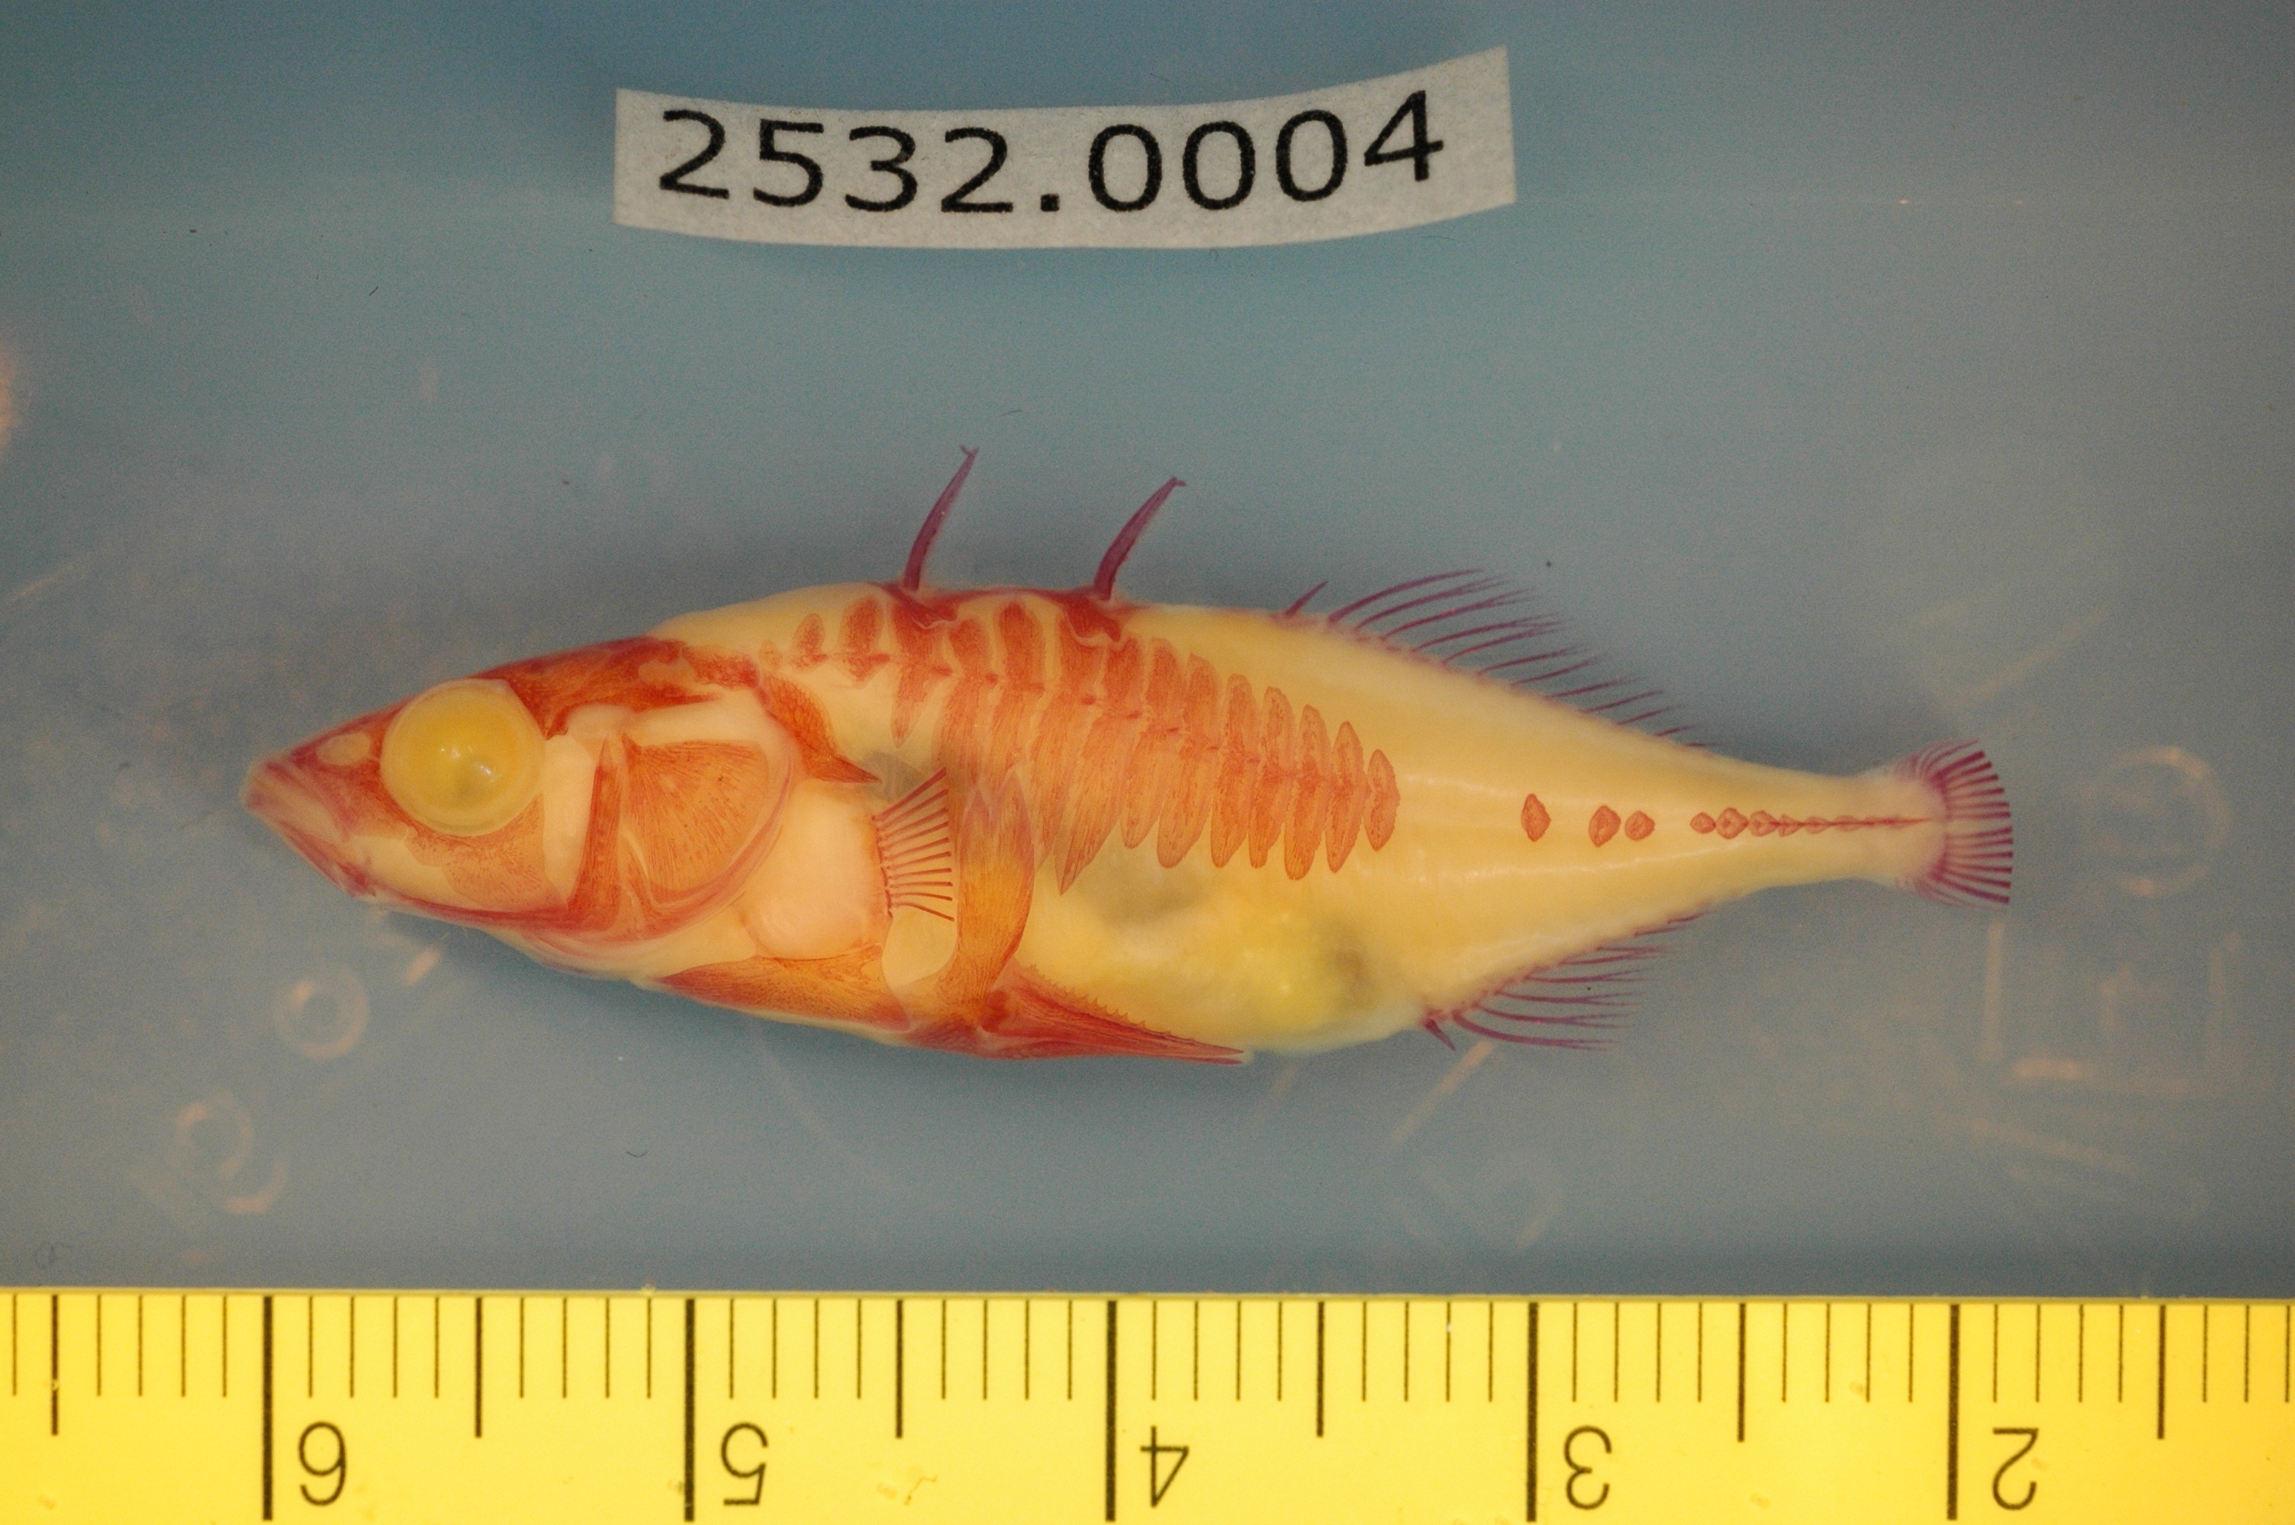
Confounders
Beyond the format of the data good datasets have limited irrelevant confounders
ML picks up on patterns, so you don’t want to add your own that might not be relevant to the question you’re asking
Columbia River
Riverbend

Slide 15
Confounders - Example
Study interested in understand Phenotype differences in two populations
Rulers placed in image for scale – Good for Consistency
ID numbers include in image – Good for reproducibility
Columbia River
Riverbend

Slide 16
Confounders - Example
Ruler color differs between collection site!
ID numbers differ between collection site
Both effects were learned by a classifier trying to predict the phenotype from the image!
Columbia River
Riverbend

Slide 17
Confounders - Lessons
You may need to clean your data before training an ML algorithm
Sometimes what's best for reproducibility is bad for ML algorithms
If you inject unique features into your data for each subject or experiment it can help you keep organized
Expect ML models to learn these features too! You’ll need to remove them before training.
This happens in other kinds of data too not just images
Columbia River
Riverbend

Slide 18
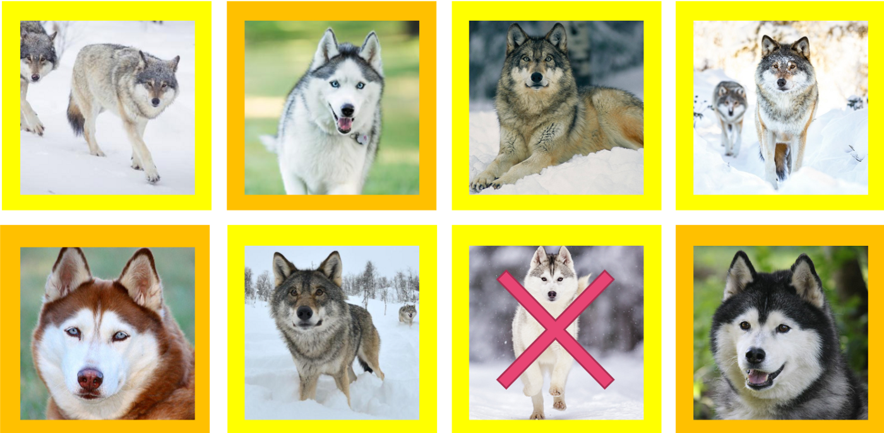
What’s the Confounder? Husky or Wolf
https://arxiv.org/abs/1602.04938

Slide 19
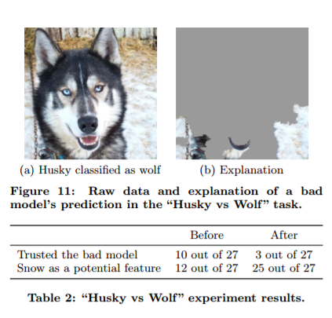
Confounders
Is it a problem?
https://arxiv.org/abs/1602.04938

Slide 20
How much data do you need for ML
A random answer on Quroa
At a bare minimum, collect around 1000 examples. For most "average" problems, you should have 10,000 - 100,000 examples.
Statements like this are common, and completely incorrect
Problem: There is no correct answer
ML finds patterns, the more obvious the pattern the less data you need
How good do you need your algorithm to work?
Better than people at something people are really good at like object recognition
A lot of data
Better than nothing
A little data
Do patterns exist?
If not then no amount of data will help

Slide 21
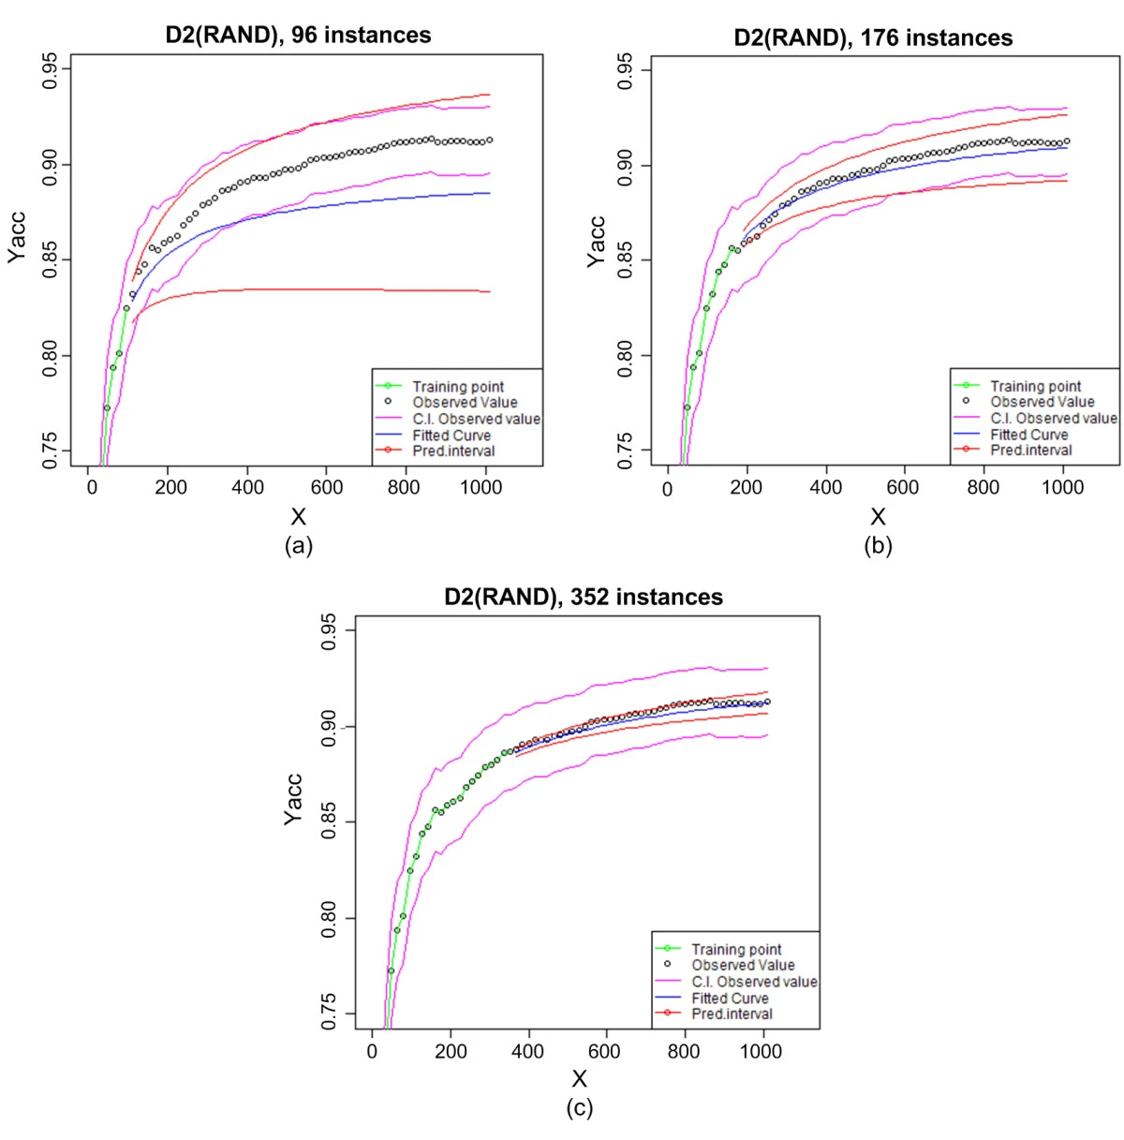
Learning Curves
Predicting sample size required for classification performance https://bmcmedinformdecismak.biomedcentral.com/articles/10.1186/1472-6947-12-8
You’ll need some data to estimate how much more you’ll need to reach a given accuracy
ML algorithms improve with data until they reach a saturation point
Can be useful to train models early in data taking to get an idea of how much more you’ll need to reach a certain goal

Slide 22
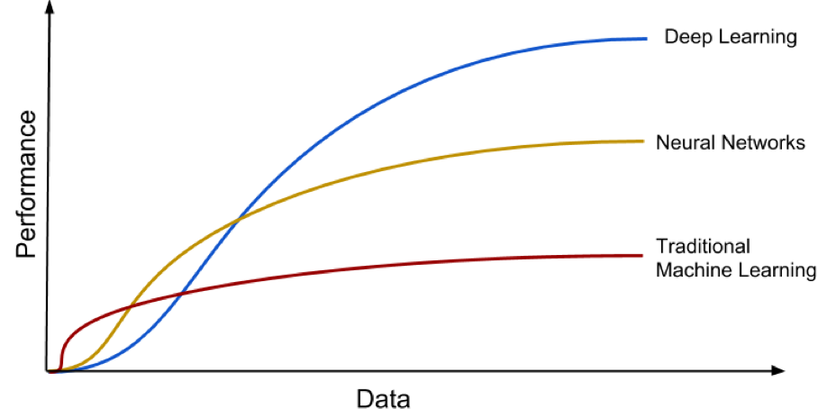
Models have different learning curves

Slide 23
Data Splits – How Much
Recommendation split data into 80% training 20% testing
What’s the tradeoff?
More testing data means better estimates of how well your model is working
More training data means the better your model works.
Another Recommendation – if this split doesn't give you enough testing data consider a different validation strategy
Cross-validation – K-Folds or leave one out
Both the above give you estimates of how well some models

Slide 24
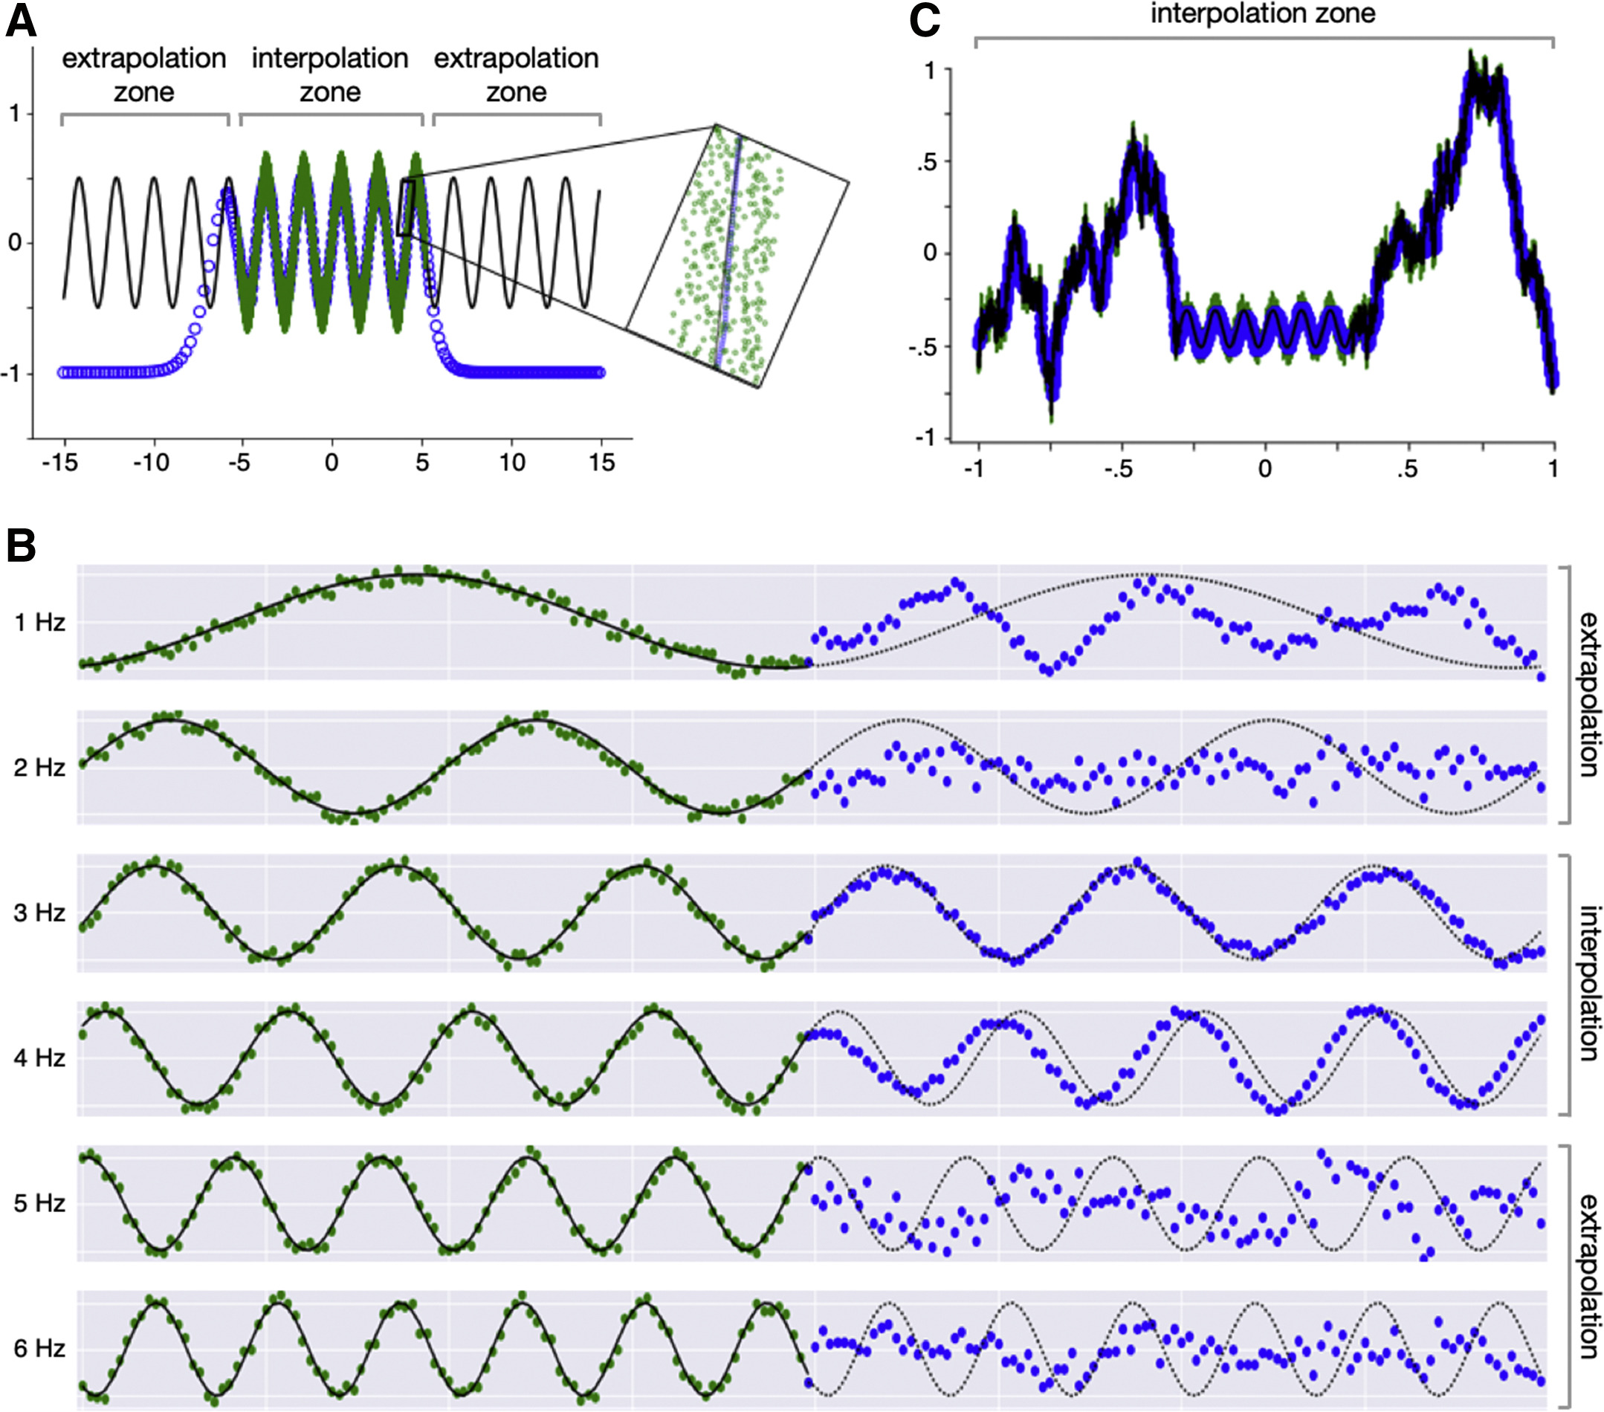
Extrapolation
ML does a lot of neat things, but it isn’t magic
Unless specified treat ML algorithms as universal function approximators
i.e. ‘Linear’ regression is not a universal function approximator
If you’re collecting data make sure you collect ’representative’ samples

Slide 25
Dataset Bias
ML classifiers and algorithms will do there best to learn what they see in there training data.
Example
Inputs: Room Temperature
Target: A random draw from a bag with 5 red balls and 5 green balls
This Input is completely un-related a well trained ML model will predict probabilities of ~50% red ~50% green
Example 2 – Same except
Target: A random draw from a bag with 10 red balls and 5 green balls
A well-trained ML model will predict probabilities of ~66% red ~33% green
If we turn our probabilities into decisions by using the >0.5 rule
Case 1: >50% is probably still random equal prediction of red and green
Case2: Red is always > 50% prediction is red all the time
When we train a model we get to decided what data we include
We can balance the classes, leave them as is, or over-sample a class
In our random example above this lets us pick an ML output anywhere from 100% red to 100% green
Whenever there is uncertainty your class balance will change your result!
Be-careful about think of these results as the truth. Think of it as the truth of the training data you selected

Slide 26
ML Experiment
Define your problem
Gather preliminary or existing data
Fit a test model
Use a learning curve fit to estimate how much more data you might need
Use importance or attribution to look for confounders that might affect your data
Gather data and experiment with new models
Deploy/Publish – Return to 6

Slide 27
Case Study: Why Amazons Automated Hiring Tool Discriminated Against Women
2014 Amazon built a model to read resumes and predict who will be successful
Inputs: Resume Terms
Outputs: Hired/Not Hired
Uncertainty in hiring is large
Dataset was historical and very Male – Gender was excluded so in theory the model shouldn’t know
Confounders – “downgraded resumes that included the word “women’s” — as in “women’s rugby team.””
In search of objectivity the model reproduced the training data’s gender bias
The model was scraped before put into production
https://www.aclu.org/blog/womens-rights/womens-rights-workplace/why-amazons-automated-hiring-tool-discriminated-against

Slide 28
Conclusions
Important Best Practices
Think about:
Possible confounders
Dataset bias and balance
Are you going to use your model on new data that isn’t representative in your training data
Dataset training/validation/testing splits are very important
or Correct Cross validation
Make sure if you split by subject if you have multiple datapoints per subject

